Slide 1
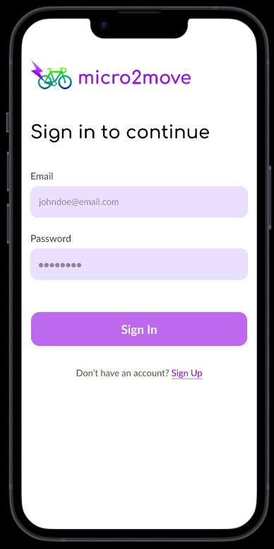

Slide 2
🚲 My Rides
🚲 My Bikes
🌐 Explore
👤 Profile
🚲 My Rides
🚲 My Bikes
🌐 Explore
👤 Profile

Slide 3
🚲 My Rides
🚲 My Bikes
🌐 Explore
👤 Profile
🚲 My Rides
🚲 My Bikes
🌐 Explore
👤 Profile

Slide 4

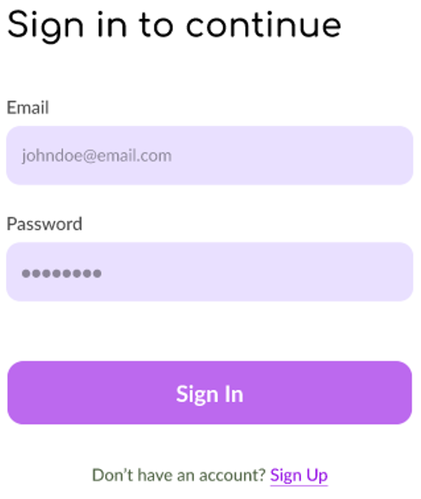
micro2move
micro2move
Sign in Screens
Invalid email/ Email does not exist.
Incorrect password. Try again.

Slide 5
micro2move
micro2move
micro2move
Sign up
Sign up
Terms & Conditions
Full Name (as displayed on government ID)
Full Name (as displayed on government ID)
Welcome to Micro2Move! Please read these Terms and Conditions carefully before using our services. By accessing or using the service, you agree to be bound by these terms. If you disagree with any part of the terms, you may not access the service. Our service allows you to connect with a community of safe biking enthusiasts, providing resources, tutorials, and e-bike sharing opportunities. We are committed to promoting safe biking practices in Sydney. You are responsible for complying with all local laws regarding biking and ensuring your safety while using our service. We are not liable for any injuries or damages sustained while using the service. For more information on our privacy policy and user responsibility… Read more
John Doe
Invalid name.
John Doe
Date of Birth
Date of Birth
Age should be 16 years or more.
DD/MM/YYYY
DD/MM/YYYY
Email (for receipts and rides)
Email (for receipts and rides)
Invalid email.
john@micro2move.com
Email already exists.
Sign up Screens
john@micro2move.com
Create Password
Create Password
⬤⬤⬤⬤⬤⬤
Invalid password.
⬤⬤⬤⬤⬤⬤
I accept the Terms & Conditions
I accept the Terms & Conditions
Take Selfie Holding
same Government ID
You must accept Terms & Conditions.
Upload Government ID
📷
Upload Government ID
Take Selfie Holding
same Government ID
⊕
📷
Continue
Selfie does not match with Govt. ID. Invalid Govt. ID
Other validation errors.
OK
Already an user? Sign in
Continue

Slide 6
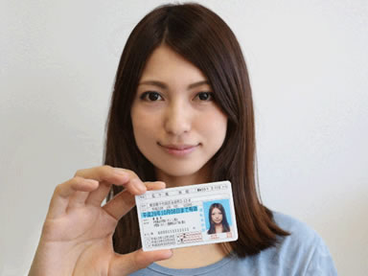
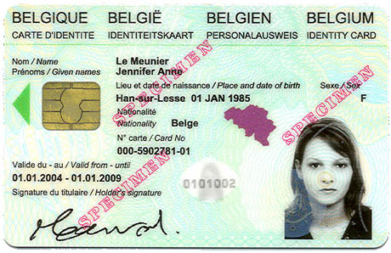
micro2move
micro2move
Sign up
Sign up
Take selfie holding your Government ID
Full Name (as displayed on government ID)
John Doe
Date of Birth
DD/MM/YYYY
Email (for receipts and rides)
john@micro2move.com
Sign up Screens
Create Password
⬤⬤⬤⬤⬤⬤
✓
I accept the Terms & Conditions
Continue
Already an user? Sign in

Slide 7
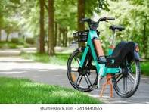
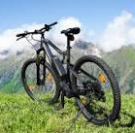
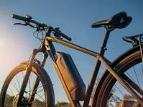
micro2move
micro2move
Welcome Owen
Welcome Owen
Your E-bikes
List your first E-bike
Owen-A1
13 Jan, 2026 – 31 Dec, 2027
🚲 Road
$/Wk 73
📍 Gate 2 B5, High St, . Kensington NSW 2052
Owner E-Bike List Screens
Owen-A2
23 Jan, 2026 – 21 Dec, 2027
🚲 Cargo
$/Wk 68
📍 E10 Union Road, . Kensington NSW 2052
Earn money while your bike is not in use.
KYC-verified users with ratings & trip history.
Digital waivers & per-ride insurance options.
Set pricing, availability, and approvals in-app.
Owen-B1
13 Jan, 2027 – 01 Dec, 2027
🚲 Hybrid
$/Wk 63
📍 Gate 2 B5, High St, . Kensington NSW 2052
List Another E-bike
🚲 My Rides
🚲 My Bikes
🌐 Explore
👤 Profile
🚲 My Rides
🚲 My Bikes
🌐 Explore
👤 Profile

Slide 8
micro2move
micro2move
📷
Your E-Bike’s Features to Check
Upload Your E-Bike’s Image
Give Your E-Bike a Name
Owen’s Bike
Battery charges and holds power
Motor assist functioning smoothly
Brakes responsive and reliable
Lights and indicators working
Display and controls operational
Tyres properly inflated, no damage
Frame, seat, pedals secure
Availability
DD/MM/YYYY
To
DD/MM/YYYY
Price Per Week (Au$)
Owner List an E-Bike Screens
70
Bike Category
Road
Pick-up – Drop-off Address
📍
I confirm all e-bike features are working fine.
List Another E-bike
🚲 My Rides
🚲 My Bikes
🌐 Explore
👤 Profile
🚲 My Rides
🚲 My Bikes
🌐 Explore
👤 Profile

Slide 9
micro2move
E-Bike Name
Owen-A2
Availability
23/01/2026
To
21/12/2027
Price Per Week (Au$)
Owner Edit an E-Bike
68
Bike Category
Cargo
Pick-up – Drop-off Address
E10 Union Road, Kensington NSW 2052
✓
I confirm all e-bike features are working fine.
Save Changes
🚲 My Rides
🚲 My Bikes
🌐 Explore
👤 Profile

Slide 10
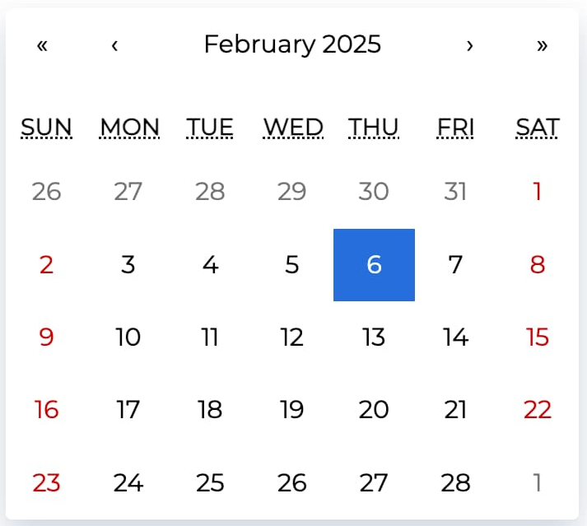
micro2move
E-Bike Name
Owen-A2
Availability
23/01/2026
To
21/12/2027
Price Per Week (Au$)
Owner E-Bike Calendar
68
Bike Category
Cargo
Pick-up – Drop-off Address
E10 Union Road, Kensington NSW 2052
✓
I confirm all e-bike features are working fine.
Save Changes
🚲 My Rides
🚲 My Bikes
🌐 Explore
👤 Profile

Slide 11
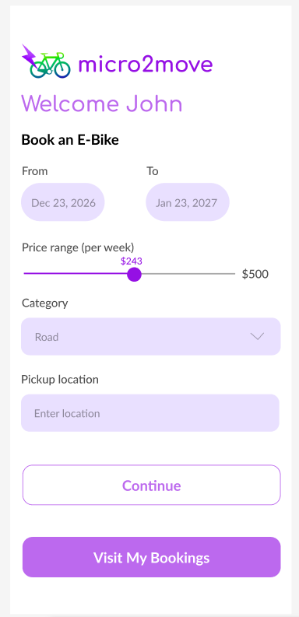
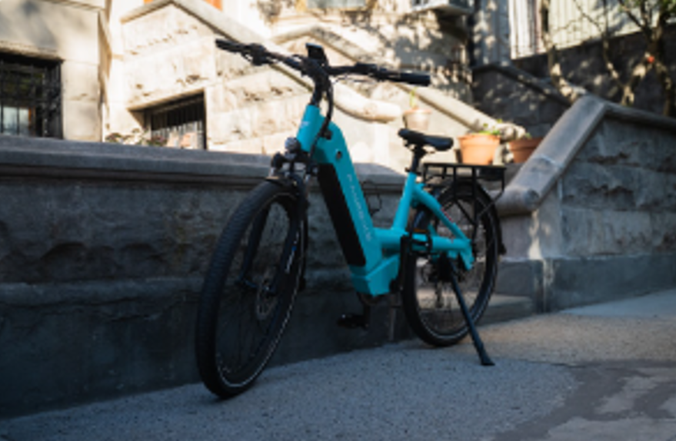
micro2move
Sam’s E-Bike (236)
Price $136 🚲 Cargo
📍 E10 Union Road, Kensington NSW 2052
Renter E-Bike Filter
Book This E-Bike
Similar E-Bikes
Owen-A2
23 Jan, 2026 – 21 Dec, 2027
🚲 Cargo
$/Wk 68
📍 E10 Union Road, . Kensington NSW 2052
Owen-B1
13 Jan, 2027 – 01 Dec, 2027
🚲 Hybrid
$/Wk 63
📍 Gate 2 B5, High St, . Kensington NSW 2052
🚲 My Rides
🚲 My Bikes
🌐 Explore
👤 Profile
🚲 My Rides
🚲 My Bikes
🌐 Explore
👤 Profile
🚲 My Rides
🚲 My Bikes
🌐 Explore
👤 Profile

Slide 12

micro2move
micro2move
micro2move
Insurance Details
Owen Daveson
E-bikes are high-value assets, and while most rides are smooth and incident-free, unexpected situations can occur. Trip insurance is designed to protect you financially and legally during your rental period, giving both renters and bike owners peace of mind.
What the insurance covers
Depending on the selected plan, insurance may cover accidental damage to the e-bike, theft during an active rental, and third-party liability arising from an incident involving pedestrians, vehicles, or property. Coverage applies only for the booked trip duration and when the e-bike is used in accordance with platform rule… Read more
Short paragraph of 200 characters max, from the user-profile of the owner, about her/himself.
Bikes Listed: 5
(132)
Community Activities
Sam’s E-Bike (236)
Price $136 🚲 Cargo
📍 E10 Union Road, Kensington NSW 2052
📅 From 23/12/2026 To 23/01/2017
View Owner’s Profile
Renter Book E-Bike
👤
Insurance Requirements
Insurance protects you from accidental damage, theft, or third-party liability during your rental. It reduces your financial exposure… Learn more
✓
Purchase mandatory insurance
Book
🚲 My Rides
🚲 My Bikes
🌐 Explore
👤 Profile
OK
OK

Slide 13
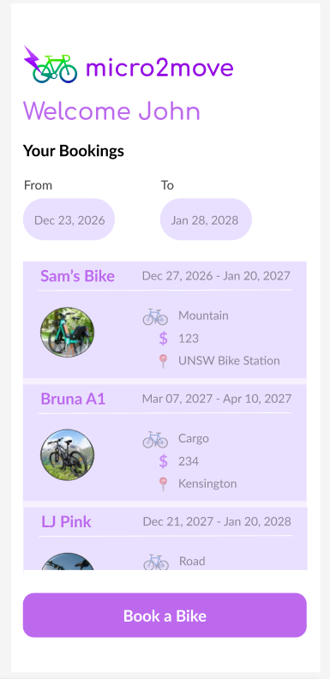
Renter E-Bike List
🚲 My Rides
🚲 My Bikes
🌐 Explore
👤 Profile

Slide 14
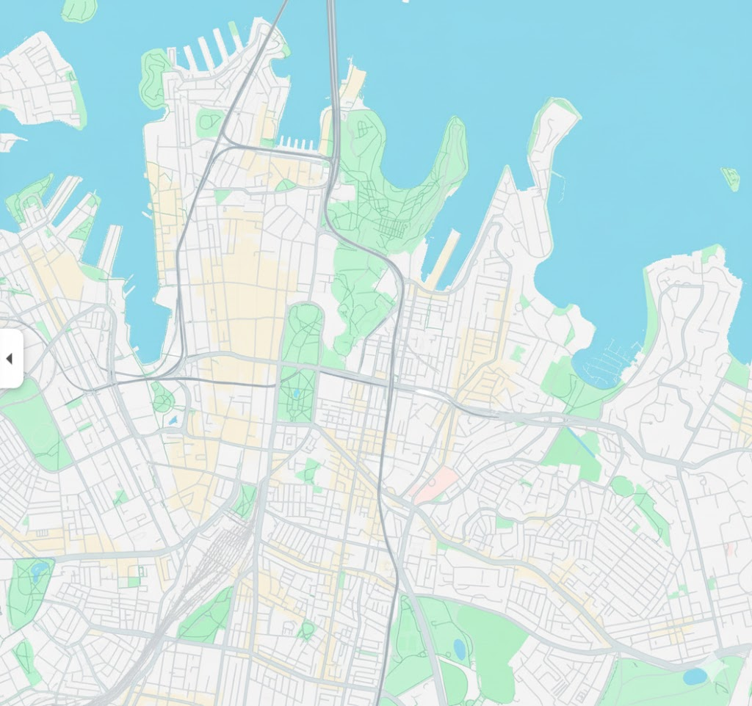


micro2move
micro2move
micro2move
Welcome John
Welcome John
Welcome John
📍
Explore Maps
🔍
Starting Point
Point A
Search
More
📍 Destination
More
Point B
More
Maps
Info
Community Update
Ask AI
Maps
Info
Community Update
Ask AI
Maps
Info
Community Update
Ask AI
🚲 My Rides
🚲 My Bikes
🌐 Explore
👤 Profile
🚲 My Rides
🚲 My Bikes
🌐 Explore
👤 Profile
🚲 My Rides
🚲 My Bikes
🌐 Explore
👤 Profile

Slide 15
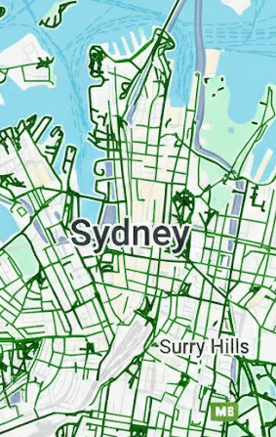
micro2move
micro2move
Welcome John
Welcome John
Current Charging Stations
Future Charging Stations
Dedicated Bike Stations
Bike Lane Infrastructure
Current Charging Stations
Future Charging Stations
Dedicated Bike Stations
Bike Lane Infrastructure
🔌
🔌
🔌
🔌
🔌
🔌
🔌
🔌
🔌
🔌
🔌
🔌
🔌
🔌
🔌
🔌
🔌
🔌
🔌
🔌
Explore Maps
🔌
🔌
🔌
🔌
🔌
🔌
🔌
🔌
🔌
🔌
🔌
Search
Search
🔌
🔌
🚲 My Rides
🚲 My Bikes
🌐 Explore
👤 Profile
🚲 My Rides
🚲 My Bikes
🌐 Explore
👤 Profile

Slide 16
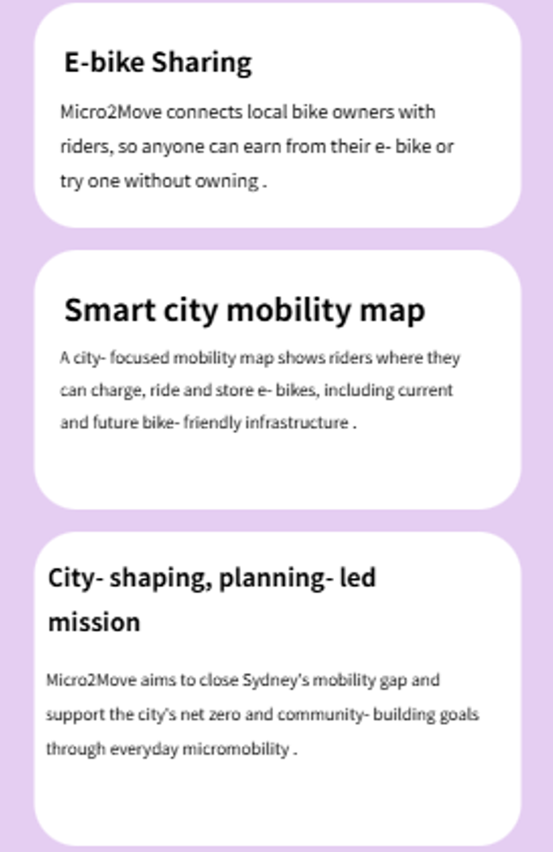
micro2move
Welcome John
Explore Info
Maps
Info
Community Update
Ask AI
🚲 My Rides
🚲 My Bikes
🌐 Explore
👤 Profile

Slide 17
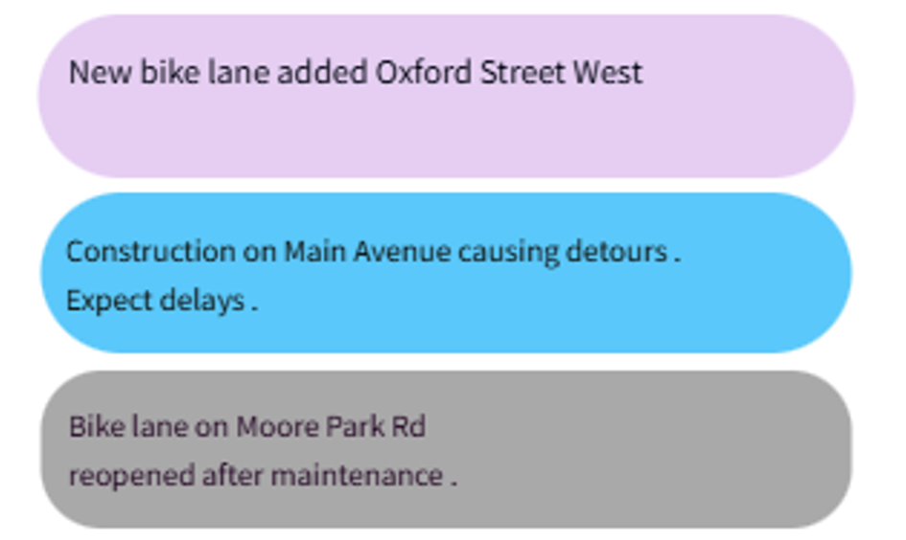
micro2move
Welcome John
Community Updates
Explore Ask AI
Maps
Info
Community Update
Ask AI
🚲 My Rides
🚲 My Bikes
🌐 Explore
👤 Profile

Slide 18
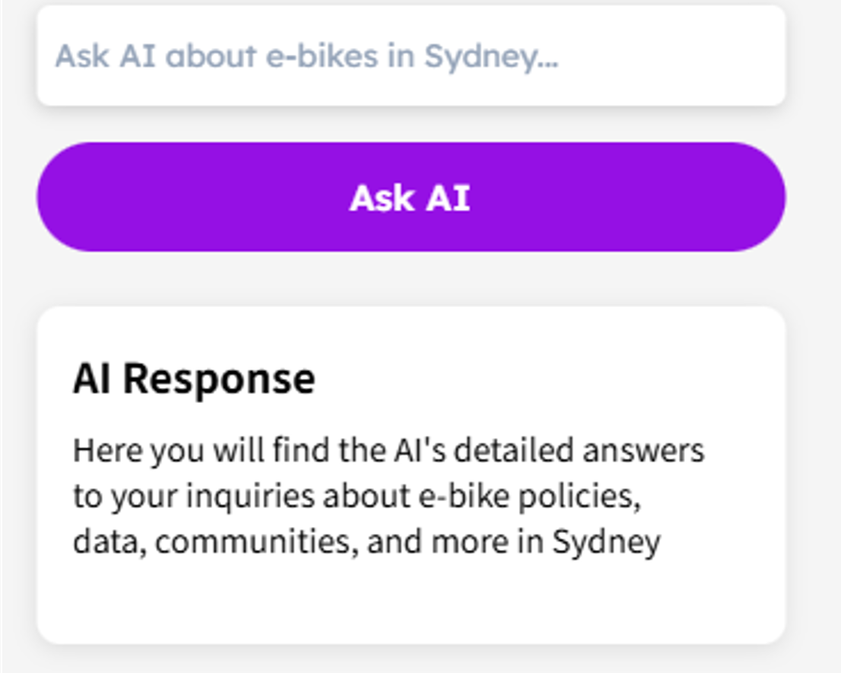
micro2move
Welcome John
Explore Ask AI
Maps
Info
Community Update
Ask AI
🚲 My Rides
🚲 My Bikes
🌐 Explore
👤 Profile

Slide 19

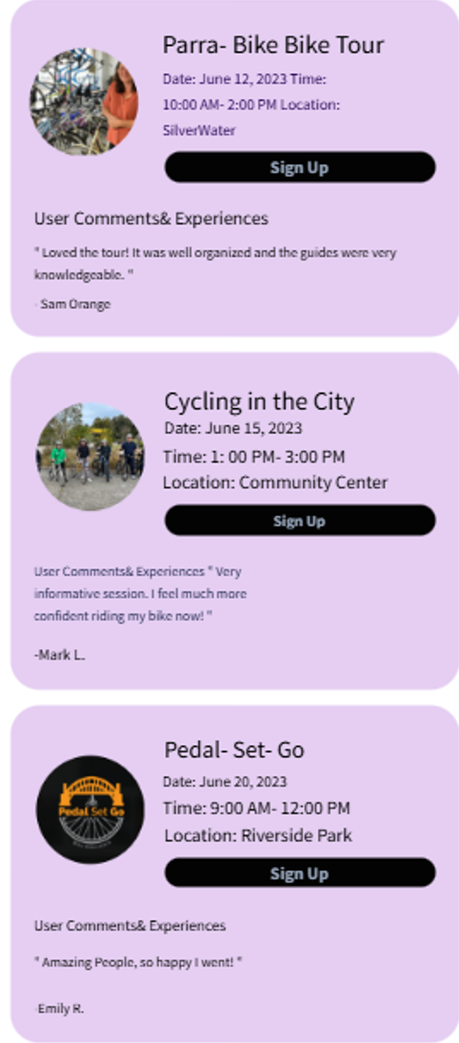
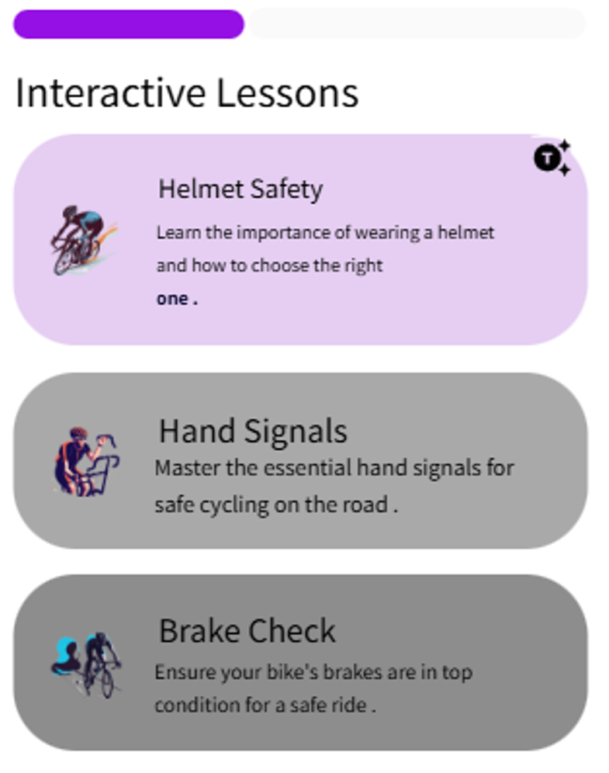
micro2move
micro2move
micro2move
Welcome John
Welcome John
Welcome John
In-App Lessons
Name: John Doe
Email: john@micro2move.com
Bikes Listed:
Listed Bikes: 5
Renter Ratings: (71)
Bikes Rented:
Owner Ratings: (12)
Joined micro2move on: 21 Jan, 2026
Community Activity 👥
In-App Lessons 📖
Logout ⭘⏻
Sign up
User Profile
Sign up
🚲 My Rides
🚲 My Bikes
🌐 Explore
👤 Profile
🚲 My Rides
🚲 My Bikes
🌐 Explore
👤 Profile
🚲 My Rides
🚲 My Bikes
🌐 Explore
👤 Profile

